Slide 1






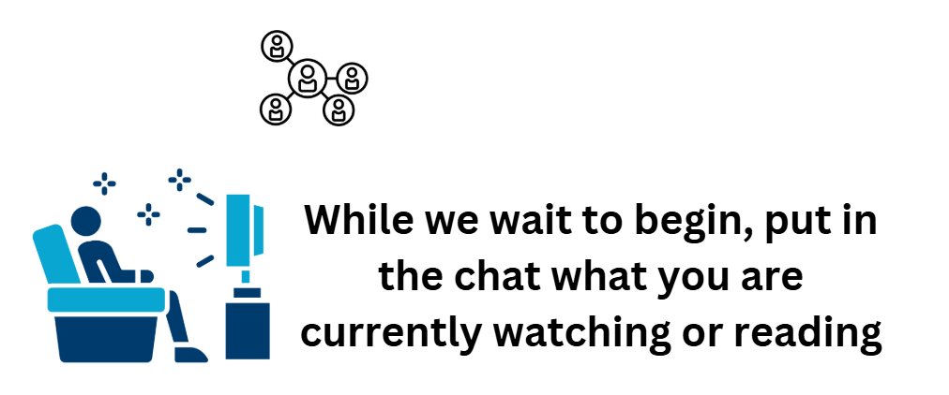

REGIONAL
DDC Meeting
  With your maars team
  March 4, 2025
Making Connections

Slide 2
Agenda
    Staffing Updates
  PD Reporting
    Updates
    State Reporting
    Regents Math and Science Course Codes
    Upcoming SIRS due dates
  Level 0
  Upcoming 20.1 release and reminders
  3-8 Testing
    Level 0 data timelines
    Answer Sheets
    Reason Not Tested Codes
    Vendor Scoring
  NYSAA Reminders
  Level 1 – Amazing Resource to Share Going Forward
  Regents
    Algebra I Pre-ID Data Due Thursday, March 28
    January scores L2RPT
    June Regents

Slide 3
Staffing Updates

Slide 4
Update your contact emails for SMS
SchoolTool | Infinite Campus
Aurilla Putney: aputney@bocesmaars.org | *Lauren_Amedeo@boces.monroe.edu
*Cherie_Nothnagle@boces.monroe.edu | *Marcia_Vick@boces.monroe.edu
*The former accounts (@bocesmaars.org) no longer go to these individuals

Slide 5




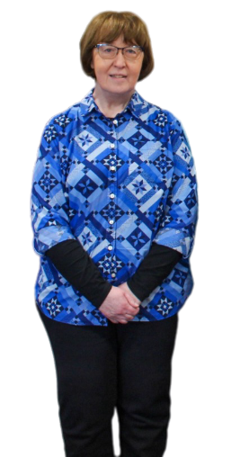

New Shared email
Mari-Ellen Maloney, 3-8 Assessment Specialist
mmaloney@bocesmaars.org will be forwarded to testhelp@bocesmaars.org
testhelp@bocesmaars.org
Mari-Ellen Maloney, mmaloney@bocesmaars.org
Patty Zeiner, pzeiner@bocesmaars.org
Ryan Maier, rmaier@bocesmaars.org
Future Assessment Specialist

Slide 6
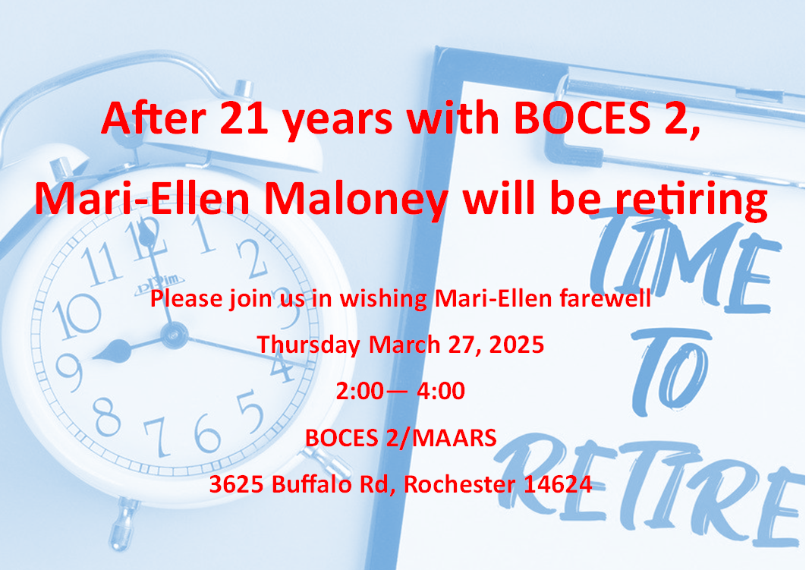

Slide 7


PD Reporting

Slide 8
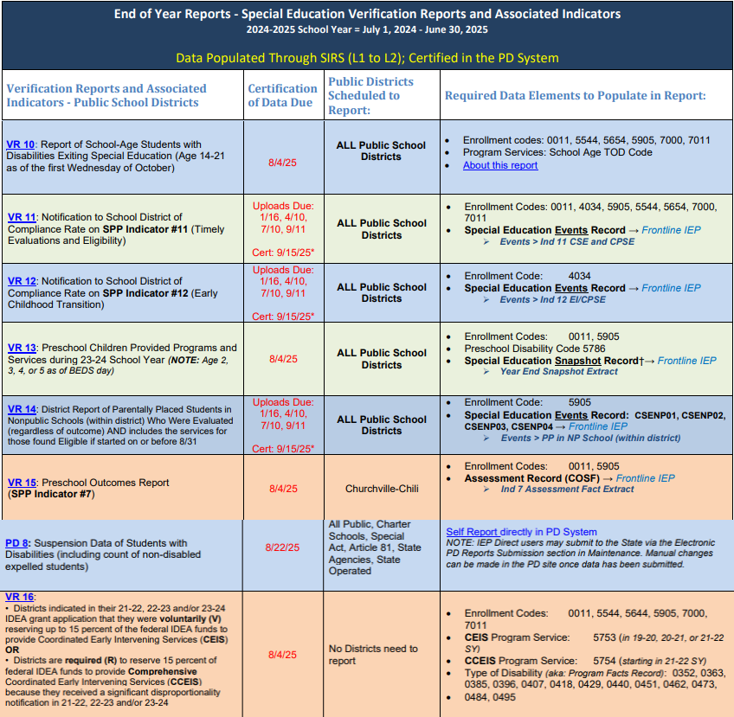

NEW: Event Reporting Required for VR11, VR12
SPP Indicator 11 (VR11) and SPP Indicator 12 (VR12) Starting 24-25 SY:
REQUIRED reporting for ALL PUBLIC SCHOOL DISTRICTS 4 TIMES A YEAR (1/16, 4/10, 7/10 9/11)
(Previously on a 6-year reporting schedule)
  Requires the Events for Indicator 11 – CPSE and CSE
  Requires the Events for Indicator 12 – EI/CPSE
SPP Indicator 7 (VR15) - Still follows SPP Federal Indicator Reporting Schedule
LAST Data due in Level 0: Thursday, September 11
Data certification due in PD Data System: Monday, September 15
  Please note the accurate certification button for both the VR11 and VR12 will not become available until the first week of June 2025
Click here to retrieve this table from the EOY PD Reporting web page
Notes:
We do have some PD reporting News!!
New this reporting year and moving forward, all public school districts will required to report Events for VR11 and VR12.
You can find the most recent version of the EOY VR reporting table on the End of Year page of the PD Reporting/MAARS website.
It can be found on the right side of the screen in the ‘Help Guide Downloads’ area

Slide 9

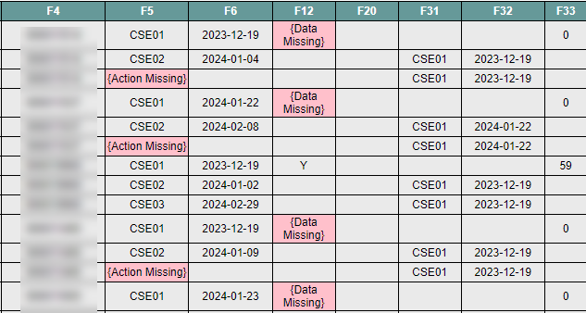
NEW: Event Reporting Required for VR11, VR12
Incomplete SE Event records can now be uploaded to Level 0 without encountering an import error in Level 0
Frontline IEP will export a student’s Events, even if the record contains a {Data Missing} or {Action Missing} field.
If you get an import error in Level 0, then it’s related to other issues, such as duplicate Events, but will still allow one set of Events to upload. Follow up with SPED department so they can make the changes in the Process Tracking log.
Notes:
Good NEWS!! Events no longer need to contain all data fields in order to upload to Level 0, which means you can upload Events at any time! Including today!!
Touch base with your SPED department to setup a regular upload schedule.

Slide 10
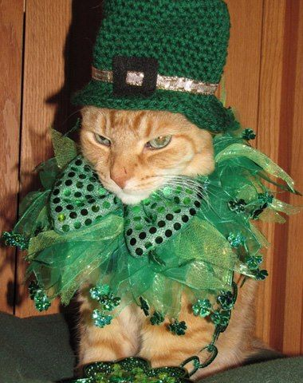
Frontline Trainings (hosted by MAARS)
Upcoming:
Topic: EI to CPSE Transitions Part 2 – Focus on Documents
March 21, 9-10:30AM
Registration: https://zoom.us/meeting/register/BRe8VIQkR2WyLDjb6A15Dw
*Keep checking MAARS weekly for upcoming trainings*
Past Recorded Trainings:
Watch HERE!
PW: data
*Recent Addition
*Transfer Students and Intake Process (February 2025)
EI to CPSE Transition part 1: Process Tracking (December 2024)
CPSE Referrals and Transition to CSE Process (November 2024)
State Reporting – October/Fall Snapshot & End of Year (October 2024)
State Reporting / Parentally Placed (June 2024)
Listings, Letters and My Insights Dashboard (June 2024)
Document Repository/Collaboration Portal (May 2024)
New Users (April 2024)
State Reporting (October 2023)
Level 0 Basic Navigation

Slide 11



Questions?
SPEDHelp@bocesmaars.org
Notes:
Reminder: Send only student ID If using screen shots, please blur out names. We can help you with how to do this if you need assistance.

Slide 12
State Reporting

Slide 13
Regents Math & Science Course Codes
(Districts, BOCES & Charters)
Exam Title | State Course Code | First Administration | Last Administration
Geometry | 02072 | June 2025
Earth & Space Sciences | 03008 | June 2025
Life Science/Biology | 03050 | June 2025
Earth Science | 03001 |  | June 2026
Living Environment | 03051 |  | June 2026
Common Core Geometry | 02072CC |  | January 2025
Use the state course code that aligns with the course content and the Regents exam students will take in June 2025
Update in Level 0
  Course Template
  Course Instructor Assignment
  Student Class Entry/Exit
Data due Thursday, March 6

Slide 14
2024-2025 BEDS Day Enrollment & FRPL
(Districts & Charters)
BEDS Day Enrollment Extract (SIRS 312, 313, 314, 316, 319)
Enrollment by grade, district of residence and supplemental enrollment counts are collected for calculating preliminary State Aid allocations
BEDS Day Free and Reduced Priced Lunch Extract (SIRS-323 and SIRS-327)
  Must be reported with 5817 – Free Lunch Program or 5806 – Reduced-Price Lunch Program
  All must have 0198 – Poverty-from low-income family
Data due Thursday, March 13

Slide 15
2024-2025 UPK Collection Opens
(Districts)
The Office of Early Learning (OEL) will use the higher student count from 2 snapshot dates
  BEDS Day snapshot date of October 2, 2024
  Snapshot date of March 12, 2025
Data can be verified in SIRS-333 Annual Pre-K Enrollment Summary Report in the Annual Outcomes folder in L2RPT
  Allocation lists for 2024-2025 can be found here: https://www.nysed.gov/early-learning/state-administered-prekindergarten-programs-allocations-and-financial-forms
  Memo: https://www.nysed.gov/memo/early-learning/2024-2025-sirs-prek-child-counts-memo
Preliminary data due Thursday, March 13
Final UPK Counts data is due Thursday, June 5

Slide 16
2024-2025 Liberty Partnership Programs
(Districts)
Under Higher Education Programs in SIRS and Level 0
Liberty Partnership Program Service Code: 4004
Data can be verified in SIRS-401 Reasonableness Report
Data is due Thursday, March 13

Slide 17
2024-2025 Out of Certification Extract
(Districts, Charters, & BOCES)
Data collected for Official State teacher certification match & appears in NYS Report Card
SIRS Templates:
  Staff Snapshot
  Course Instructor Assignment (CIA) – teaching assignment
  Student Class Entry/Exit (SCEE) – roster
L2RPT Verification:
  SIRS-320 Staff Snapshot
  SIRS-330 Student Class/Course Instructor Summary
  SIRS-328 Out of Certification and SIRS-329 Staff Certification Reports to review teaching assignments
Resources:
  2024-2025 Teacher Course to Certification Crosswalk (IRS Portal): maps each course to all certification areas that are approved to teach that course
  NYS Comprehensive Course Catalog (http://www.p12.nysed.gov/irs/courseCatalog/): contains a list of state courses along with their state course code and brief description
Final Teacher Out of Certification data due Thursday, May 15

Slide 18
CIA/SCEE and Student Daily Attendance
(Districts, Charters, & BOCES)
Data collected by Office of Accountability for student growth purposes
SIRS Templates:
  Staff Snapshot
  Course Instructor Assignment (CIA) – teaching assignment
  Student Class Entry/Exit (SCEE) – roster
  Student Daily Attendance through May 2
L2RPT Verification:
  SIRS-320 Staff Snapshot
  SIRS-330 Student Class/Course Instructor Summary
  SIRS-360 Student Attendance Summary Report
  SIRS-371 Student Attendance Count Report
  SIRS-375 Student Attendance Count (by District) Report
Data due Thursday, May 15

Slide 19
Summer EBT 2025 Benefits
(Districts & Charters)
SIRS Templates:
  Student Lite: Demographic
  School Entry/Exit: Enrollment
  Program Fact: FRPL, homeless & foster care
Verification:
  Verify student guardians and home address are accurate
  SIRS-401 Reasonableness report
    FRPL
    Homeless
    Foster Care
Data due Thursday, May 29

Slide 20
Level 0

Slide 21


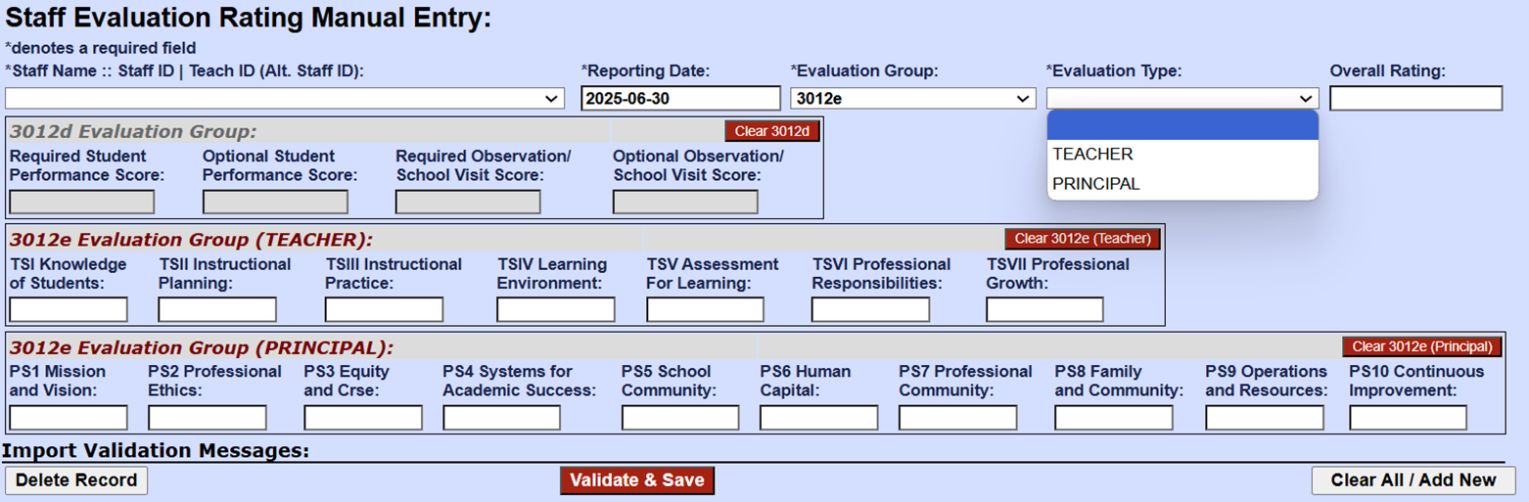
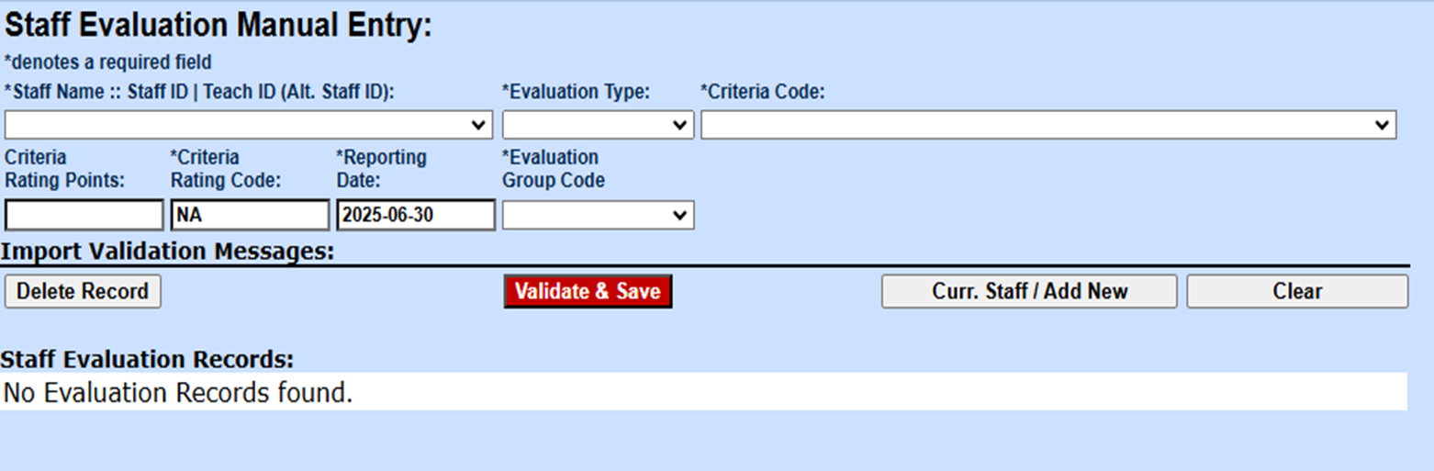
Level 0: version 20.1 (tentative release target in March)
Eval Plans: https://www.nysed.gov/sites/default/files/programs/educator-quality/implementation-teacher-principal-evaluation-systems-2024-25-school-year-and-thereafter-pursuant-to-education-law-3012-d-and-3012-e-amended-chapter-143.pdf

Slide 22
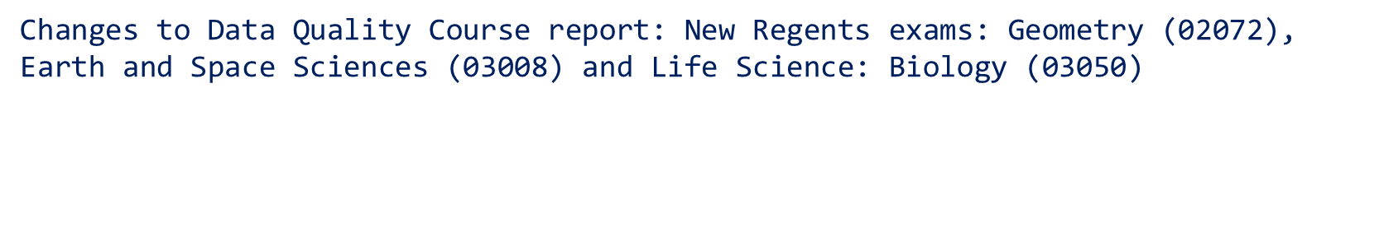
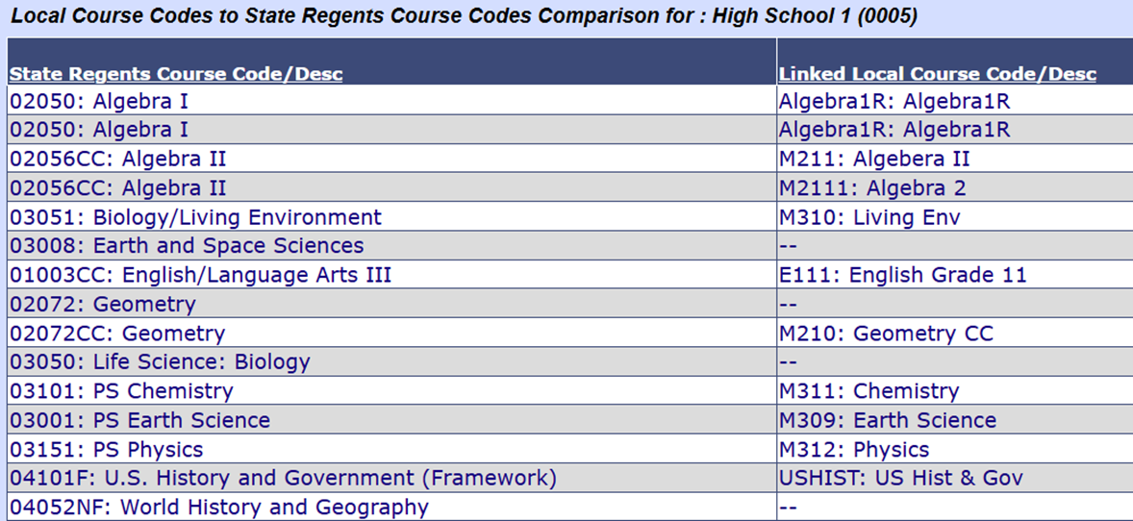
Level 0: version 20.1 (tentative release target in March)

Slide 23
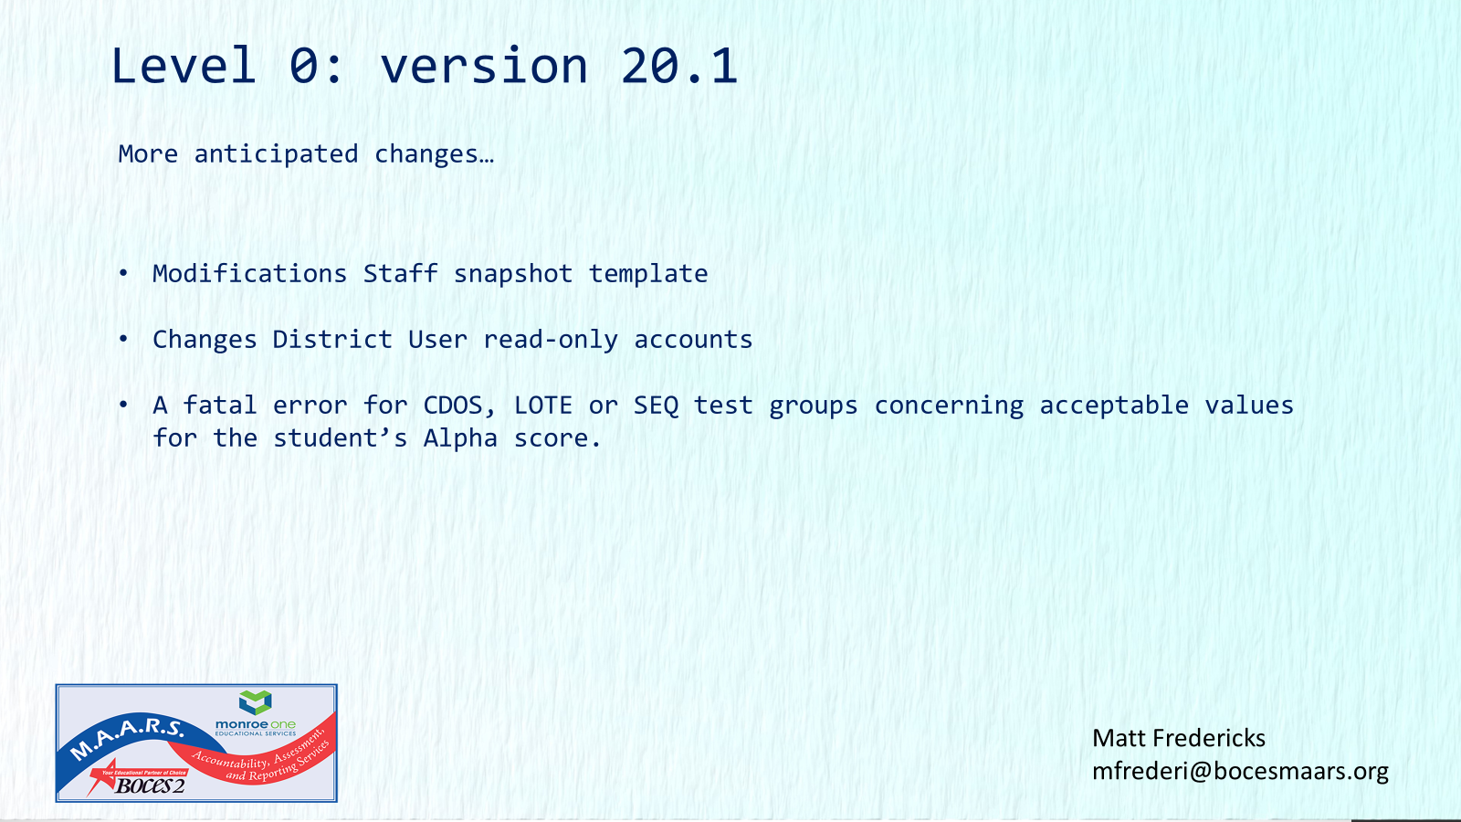

Slide 24
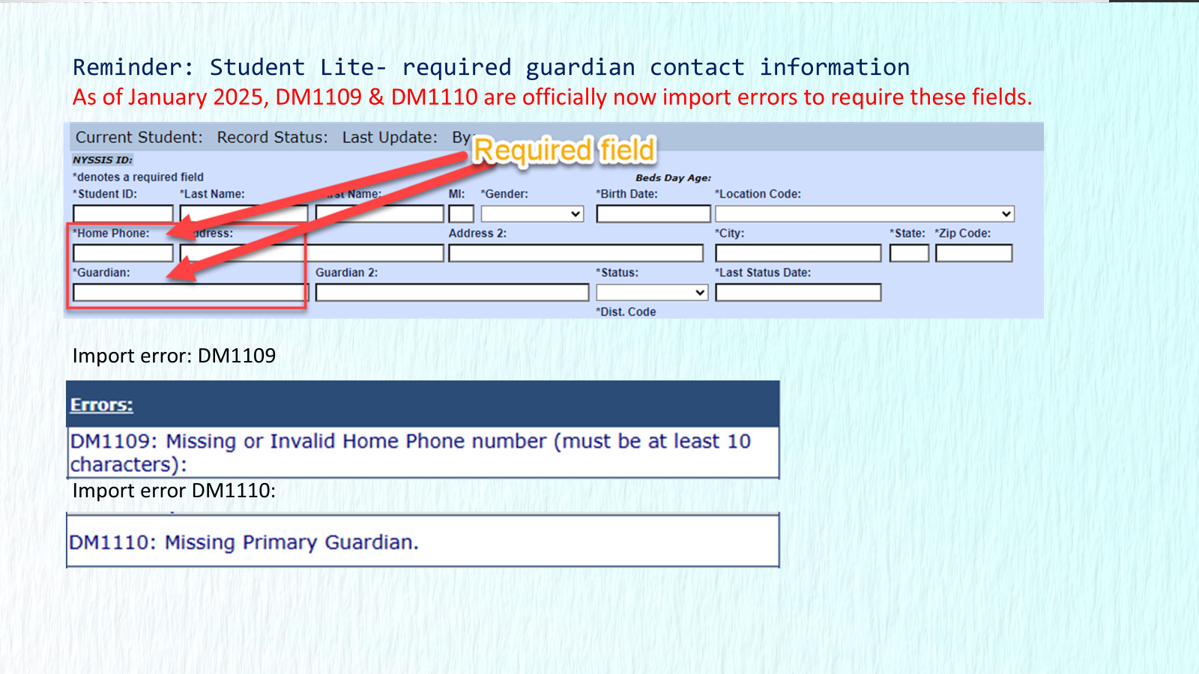

Slide 25


Slide 26
Level 0 and ASAP Webserver
During the week of February 20-24 we moved the following applications to a new server
  Level 0
  Level-0 Test
  ASAP
We thank you all for your patience while these applications were unavailable during this time
Please contact Matt Fredericks if you experience any issues with any of these applications
Upgrades
  Level 0 and Level-0 Test were upgraded to 18.02
  ASAP was upgraded to 4.0.14

Slide 27

SED Testing Updates

Slide 28


3-8 Testing - ELA, MATH, SCIENCE, NYSESLAT
PBT and CBT

Slide 29

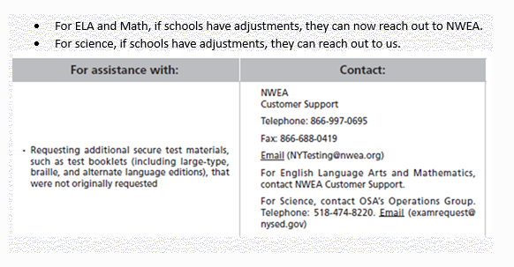
Contacting NWEA or NYSED for Testing Materials
If you need additional test booklets / Testing materials...
For ELA & Math reach-out to NWEA... For Science Reach out to NYSED.
Contact information is listed in the chart below.
You can also find some manuals on the following NYSED Websites (links below)
2025
English Language Arts, Mathematics, and Science Test Manuals, Educator Guides and Teacher's Directions | New York State Education Department

Slide 30

Important Dates both PBT & CBT
IMPORTANT DATES AND DEADLINES --- 2024 - 2025 | Due Dates
Operational CBT: Date to have all student data Up-To-Date-in Level 0 and pushed-up to Level 1 for DW load. | February 21
Operational ELA, Math and Science Classes and Students Tabs are available | March 10th
Operational ELA, Math and Science Tests Tabs are available | March 24th
Operational ELA, Math and Science Student Login Tickets Available to print | March 24th
(ANSWER SHEET PROCESSING)
ELA all answer sheets must be to us for processing | May 19th
Science All answer sheet must be to us for processing | May 23rd
MATH all answer sheets must be to us for processing | May 29th
NYSESLAT All answer sheets must be to us for processing | June 6th

Slide 31

CBT Student Accommodations
(CBT)
(LINK): Setting Student Testing Accommodations for CBT - Quick Reference Guide
  See link above to download a copy of the Testing Accommodations Quick Reference Guide for CBT. The guide is located at the bottom of the screen when you click the link above.
  Multi-Student Setting of Accommodations (Multi Student Edit):
    Please keep in mind, When setting accommodations for multiple students simultaneously.
      Multi-Student Edit will over-write any previously assigned student individual accommodations
  Best practice is to set all your Multi-Student Accommodations first then add any individual student accommodations where needed.

Slide 32

ADDING 7th GRADE STUDENTS TO GRADE 8 SCIENCE VIA NEXTERA ADMIN
(CBT)
NYSED has an article still posted in CBT Support from last year concerning grade 7 students taking Science 8 CBT:
This article talks about the adding of 7th graders to Nextera that need to take the grade 8 Science. (see link to article below)
  Adding Grade 7 Students to Grade 8 Science
  Any questions, please contact Mari-Ellen Maloney
  mmaloney@bocesmaars.org or 585-349-9025

Slide 33

CBT 8th Grade Students Taking Regents
(CBT)
Friendly Reminder:
If you have 8th grade students loaded into Nextera that are taking Regents instead of taking Science 8 and/or Math 8:
  Please remember to enter a reason not tested of “Taking Regents” into Nextera for that students Science 8 exam and/or Math 8 exam.
  NOTE: If the 8th grade Regents student was not loaded into Nextera, you do NOT need to enter the student into Nextera just to give them an RNT of "taking regents".
  If you have any questions, please do contact me.

Slide 34
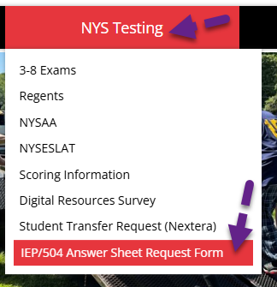
Ordering Paper Answer Sheets for IEP/504 CBT Students​ ​
Important reminders: CBT grades 4, 5, 6, 8 (and grades 3&7, if the grade levels are CBT) In your schools:
A Student must have an IEP/504 in-order to take the paper version of the test.
To order answer sheets for these CBT students we have created a new form.
This form is now located on our website under "IEP/504 Answer Sheet Request Form"
Complete this form and post it on our SFTP site in the following folder
Test booklets should have already been ordered for these students during the NYSED assessment ordering window. If you need additional test booklets, you can still order them directly through NWEA.
Contact Info. --> 1-866-997-0695 or NYTesting@nwea.org

Slide 35
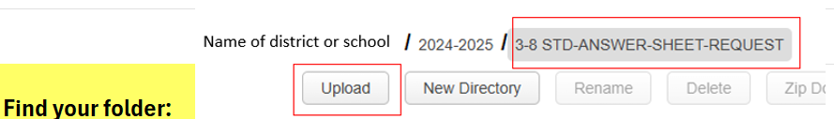
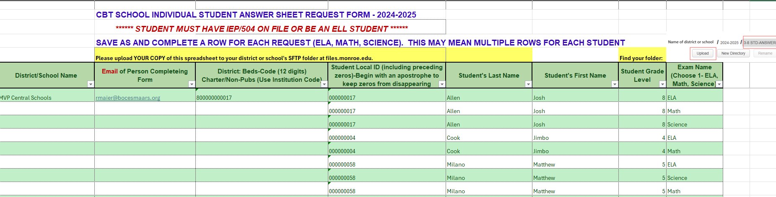
Ordering Paper Answer Sheets for IEP/504 CBT Students​ ​
Complete this form and post it on our SFTP site in the following folder
"3-8 STD-ANSWER-SHEET-REQUEST"
*****************************
Once posted, please contact mmaloney@bocesmaars.org or testhelp@bocesmaars.org to let me know that you have posted an order form for your CBT IEP/504 students paper answer sheets.

Slide 36

Paper Answer Sheets for CBT Students - Continued
(CBT)
Our goal is to have all answer sheets printed and shipped out (districts) and ready for pick-up (Charters & Non-Public) before the testing window opens.
Delivery and pick-up dates coming soon
  If you have any questions or concerns, please do contact me.

Slide 37

3-8 Testing - General Reminders Concerning Reason Not Tested Reporting
(CBT)
Administrative Error: a 2-step reporting process which includes both a letter written by the principal sent to NYSED & entering the reason not tested into Nextera Admin.
Remove session absent when student has completed that session of the test.
Students that have a not tested code and have answers on that test session; that test may not receive a final score.
Students that are enrolled at time of test but did not complete the test must have a not tested code “reason” entered in each of their session status for the test not completed.
Review all sessions status, look for any incomplete sessions or sessions still in progress.
  These need to be investigated and resolved before the testing window closes.

Slide 38
3-8 Testing – General Reminders Concerning Reason Not Tested Reporting
(CBT)
NOT TESTED CODES FOR OPERATAIONAL 2025 TESTING – in NEXTERA ADMIN:
(deadline to complete and finalize all student session(s) not tested code entries in NEXTERA ADMIN.)
(Includes a helpful CBTsupport article & document)
ELA, MATH and SCIENCE --- (Nextera will close apoximitly one week after the testing window ends)
Tentive Date (May 30th) More info Coming from NYSED.
PLEASE make sure your CBT schools are aware of this date!
This is the last opportunity they will have to update/review their student’s Not-Tested Reason entries into NEXTERA!
Please also remember it is the district/school’s Test Coordinator’s responsibility to make sure these are accurate before the deadlines.
Missing a reason not tested could cause the student not to get a final score on the part of the test they may have completed.
Helpful CBTsupport article and document: How to Set Not Tested Codes
Please read through this article and Quick Reference Guide located at the bottom of the article.
  It will show you how to down-load the Test Status Detail Report from NEXTERA.
It is very important that each school down-load the Test Status Detail report to review the students’ test status for all sessions, make any needed additions or corrections to the reason not tested before the test window closes. Keep in mind there are 2 sessions for ELA and Math. Both sessions may or may not need a reason not tested.
This report will also help identify any student that may not have completed the test (Exp: Absent) that will need to sit for a make-up, before the testing window closes.
Once all make-ups are done and all Not Tested Reasons have been updated, it is strongly recommended that the district/school Test Coordinator down-loads a final copy of the Test Status report file and keep it as a reference. As this will be the only reference, they will have on their student test status once NEXTERA closes.

Slide 39


3-8 Testing – Questions?

Slide 40
NYSAA/NYSESLAT

Slide 41
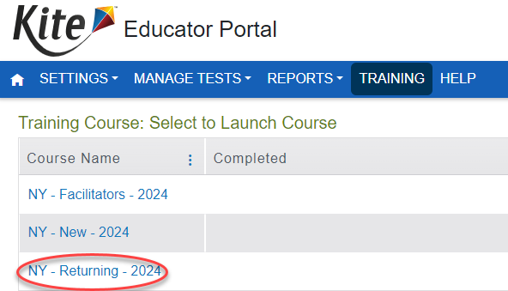
NYSAA (Alternate Assessment)
Test Window March 11 - June 7
All teachers should have already completed:
  Required Annual Administrator Training
    New: Self Directed option located on Kite Educator Portal
  First Contact Survey and Personal Needs and Preferences for each student
  Teachers can reach out to Lorena lstabins@bocesmaars.org if a Monroe 2-Orleans BOCES District or Jamie Schnaus jamie_schnaus@boces.monroe.edu if a Monroe One BOCES District
Special Circumstances Codes must be entered before window closes
  Information on Special Circumstances Codes (Medically Excused, Absent, Parent Refusal, etc.)
  Questions, reach out to Mari-Ellen mmaloney@bocesmaars.org

Slide 42
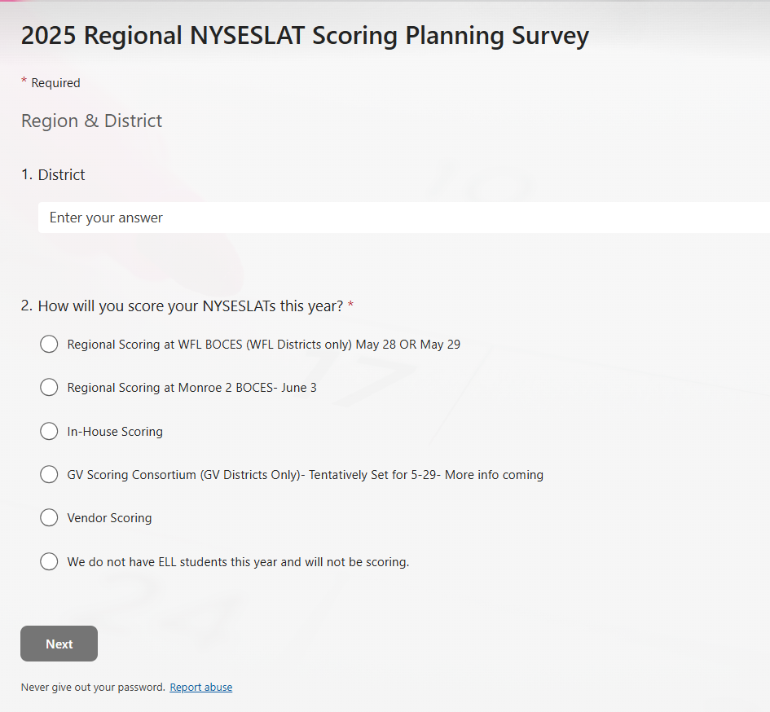
NYSESLAT – Regional Scoring Survey
(RH, Webster, Brockport)
RBERN Coordinator: Nikki Bell
Nbell@monroe2boces.org

Slide 43
Level 1

Slide 44
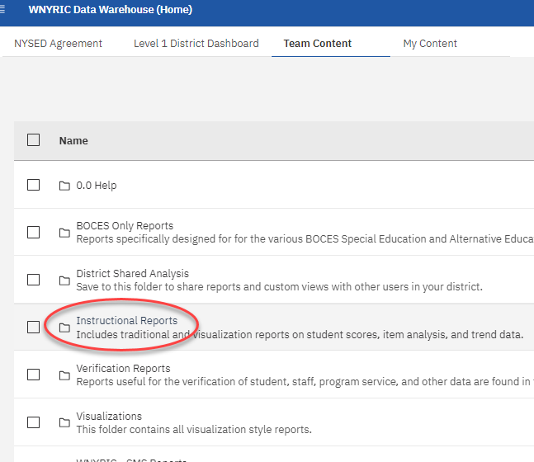
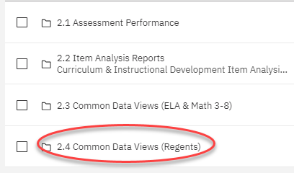
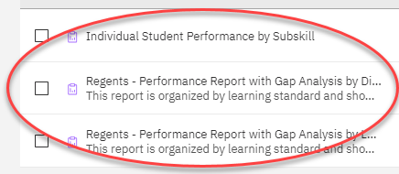
Item Analysis for January 2025 Regents Now Available

Slide 45
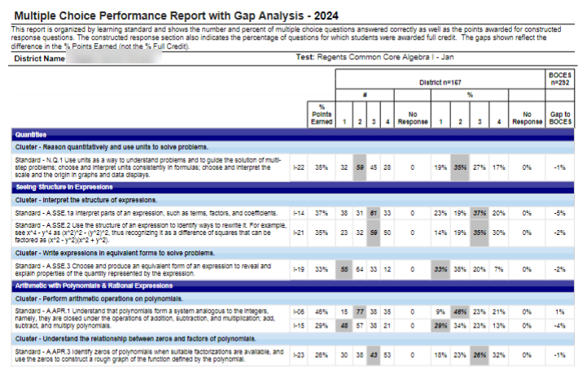
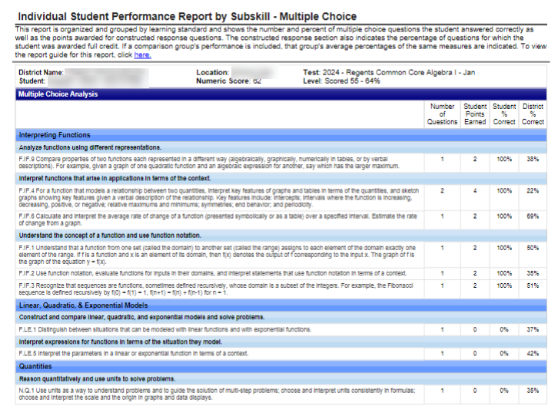
Example of Jan Regents Reports Mapped to Standards

Slide 46


A "gift" teachers and principals would love to receive from you!

Slide 47
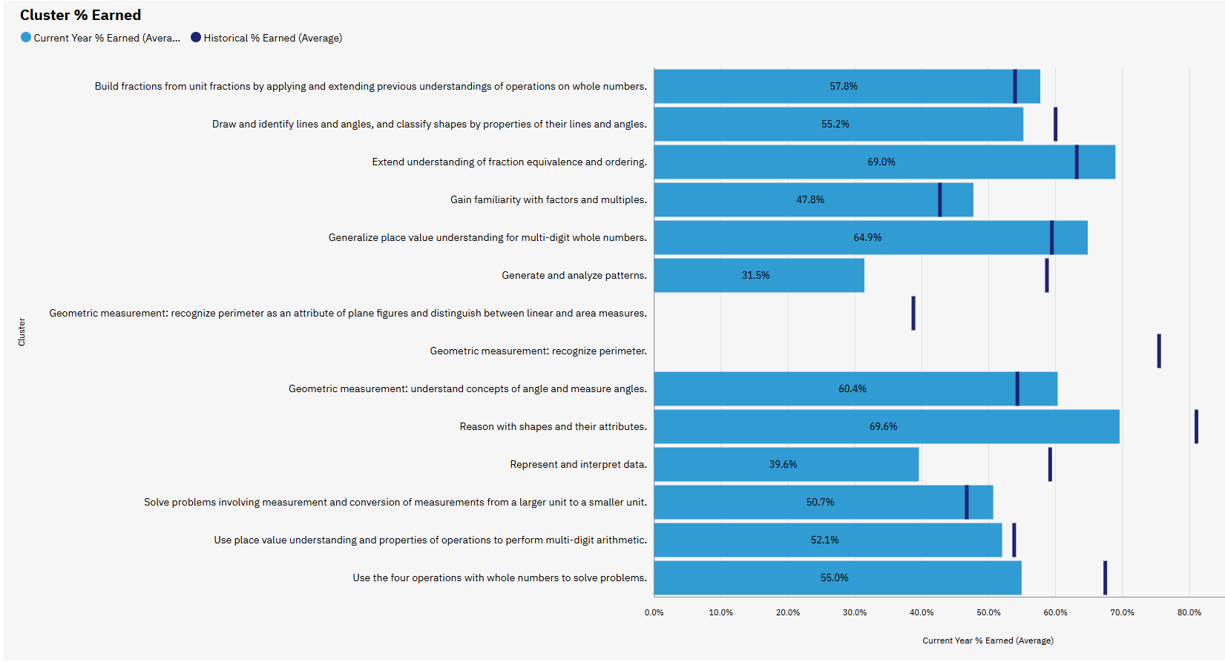

Slide 48
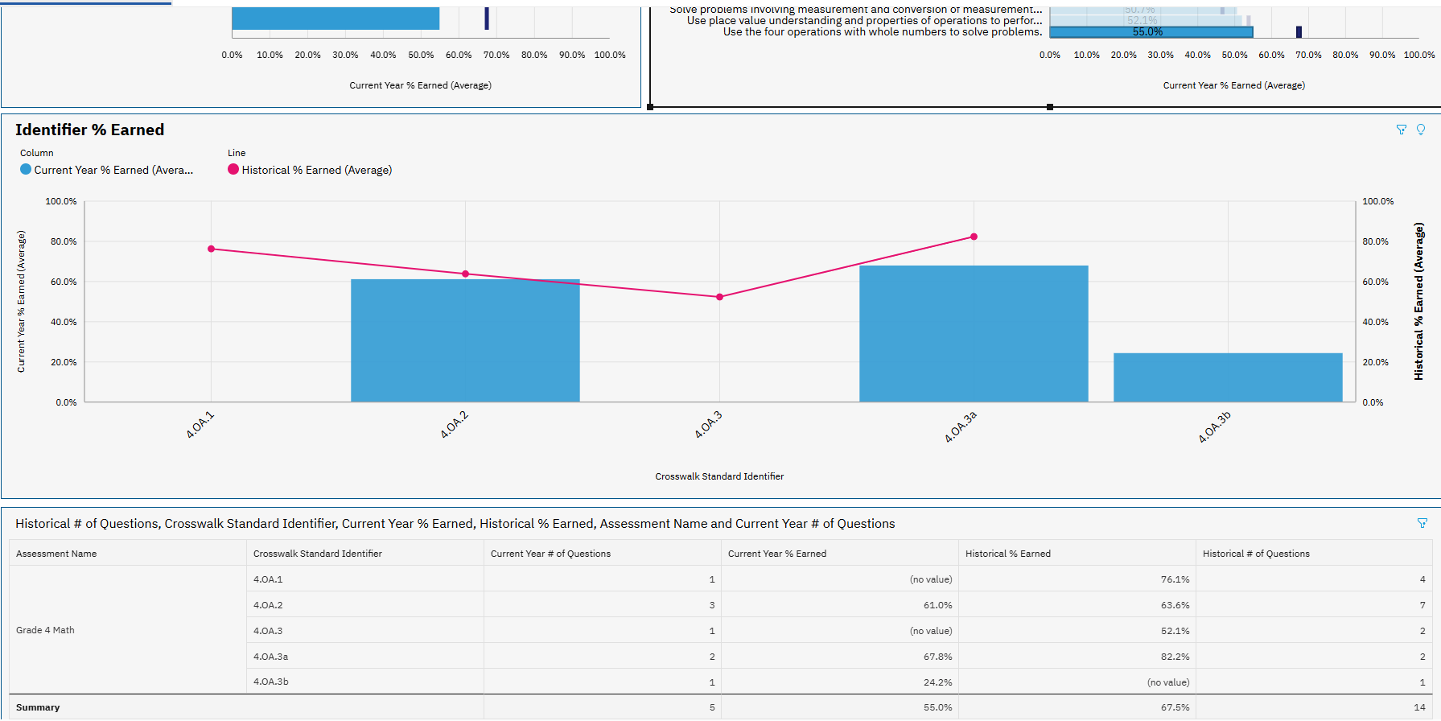
Clicked on a frequently tested cluster that we were underperforming in.

Slide 49
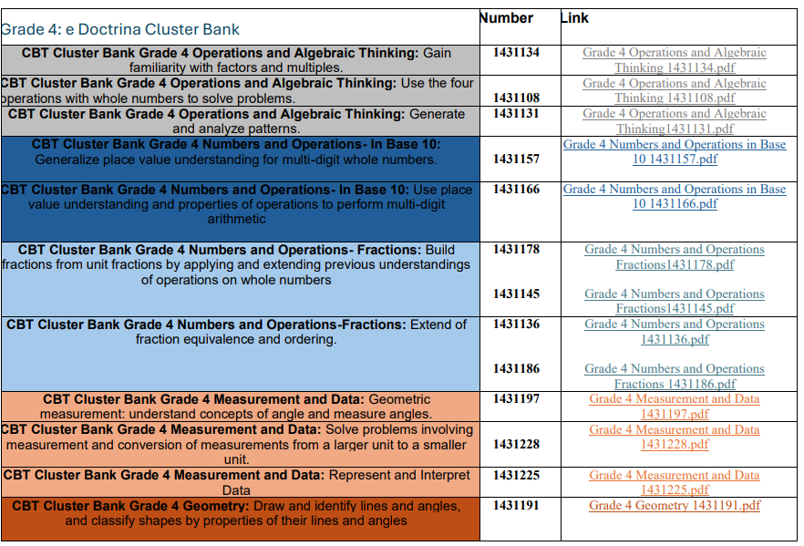
Use MAARS' eDoctrina tests
That same cluster!

Slide 50
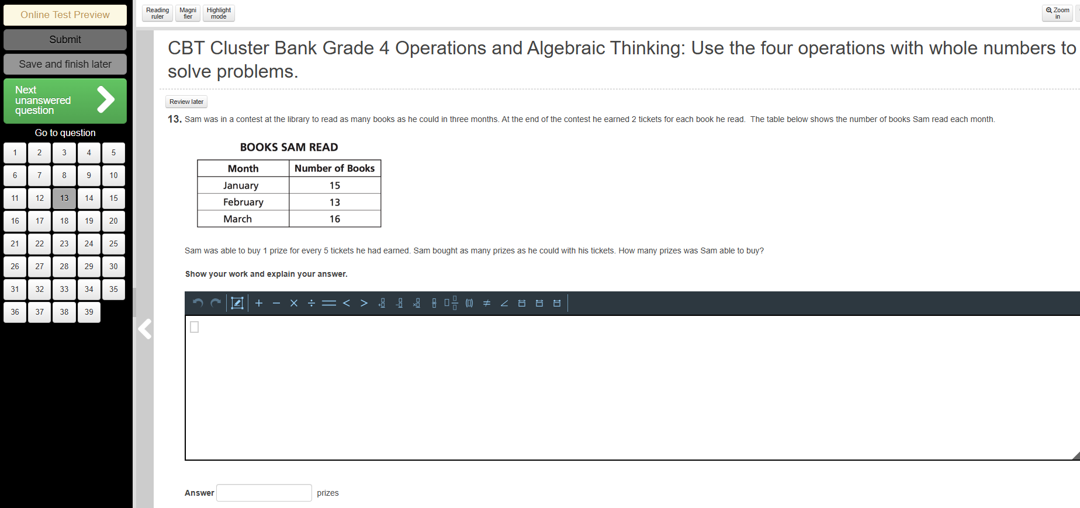
39 questions to choose from!

Slide 51
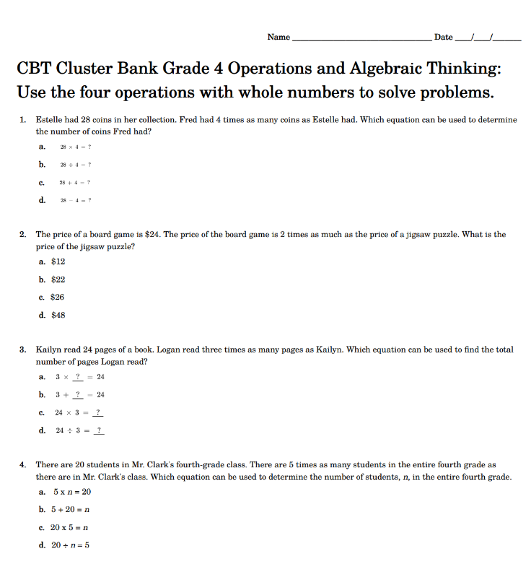
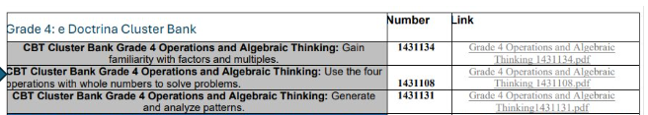
Not forgetting our Non-eDoctrina Districts & Schools

Slide 52
Handout Posted on our Website!

Slide 53
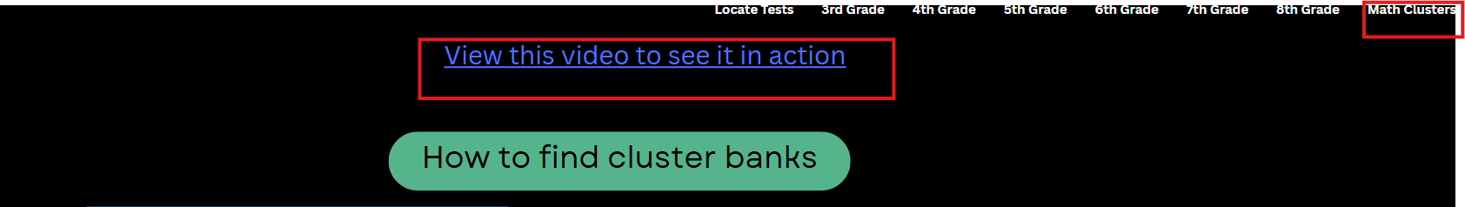
The cluster banks are on our website : CBT Practice: 3-8 Assessments from MAARS
*if you have any questions, I invite you to contact me at dlubbert@monroe2boces.org

Slide 54
Regents

Slide 55
JANUARY REGENTS
January Regents scores have been loaded to Level 2
Please verify all information is accurate.

Slide 56
REGENTS
Pertinent information (including the highlights below) have been updated in the MAARS website .
Ordering Exams with the Office of State Assessment by April 11th.
M.A.A.R.S. Pre-printed answer sheets:
  MAARS order form for preprinted answer sheets due April 11th
  Files of student demographic information is due April 18th to MAARS through the secure Monroe FTP site. Please do not email files of student information!
  Any needed additional walk-in files are due June 6th and will continue to be accepted by MAARS up to exam time. Last minute answer sheets will be printed to a PDF file and sent to the school for printing.
  Do not make copies of pre-printed or blank answer sheets for students to use.
  MAARS will start preprinting answer sheets in the first week of May. They will be shipped to Districts/BOCES starting by May 26th. We will notify the other schools when their answer sheets are ready to be picked up at MAARS.
  Any questions, please contact Patty Zeiner 349-9053 or pzeiner@bocesmaars.org

Slide 57

Questions?

Slide 58
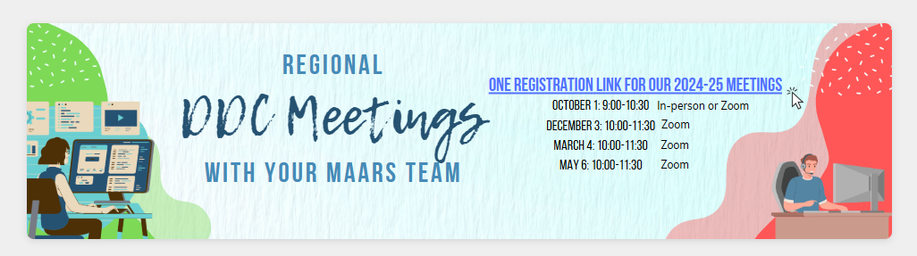


May 6

